Slide 1
Proximity Labeling
Enzymatic Proximity Labeling Approaches for In Vivo Interactome Characterization (ex: BioID, TurboID, APEX)
Ian Sofia
Notes:
Welcome everyone. Today we are discussing enzymatic proximity labeling (PL) approaches—specifically BioID, TurboID, and APEX
. These tools have revolutionized how we characterize the "interactome"—the complex network of molecular interactions within a living cel

Slide 2
Content
Introduction
Principle of Proximity Labeling
Mechanism and Enzyme Development
  BioID
  TurboID
  APEX
Applications
Extensions

Slide 3
Introduction
Molecular interactions underpin cellular life, including protein–protein, protein–RNA, and protein–DNA interactions.
Traditionally, molecular interactions have been studied using methods such as affinity purification, yeast two-hybrid, BiFC, GST pull-down, and co-immunoprecipitation (Co-IP).
Notes:
Molecular interactions are the foundation of life, spanning protein-protein (PPIs), protein-RNA, and protein-DNA interactions
. Traditionally, we have relied on methods like affinity purification, the yeast two-hybrid system, and co-immunoprecipitation (Co-IP) to map these connections

Slide 4
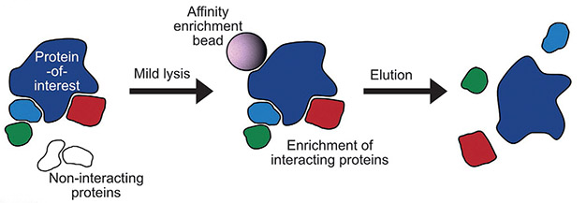
The Paradigm Shift
Limitations of Traditional Interaction Detection Methods
Steps of Co-immunoprecipitation
This approach assumes that protein interactions are sufficiently stable, which leads to the loss of weak or transient interactions.
Pfeiffer et al.Methods in Cell Biology 2022

Slide 5
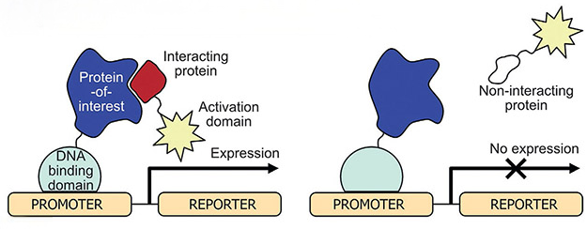
The Paradigm Shift
Limitations of Traditional Interaction Detection Methods
Principle of Yeast-two-hybrid
This Yeast-two-hybrid system ignores native localization, post-translational modifications, and cellular environment
Pfeiffer et al.Methods in Cell Biology 2022

Slide 6
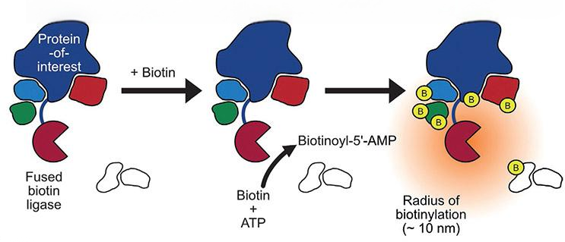
The Paradigm Shift
How to solve this problem?
Yeast-two-hybrid
Proximity Labeling
Co-immunoprecipitation
Label by complex
Label by proximity
Pfeiffer et al.Methods in Cell Biology 2022

Slide 7
The Paradigm Shift
A Paradigm Shift: From Complex to Proximity Labeling
In situ labeling
Spatial proximity
Captures transient interactions
Detects weak interactions
Adapted from Khan et al., 2020, Frontiers in Genetics
Notes:
Traditional methods often fail to capture transient or weak interactions and can disturb the natural cellular environment during lysis.
This leads to a shifft of PL
Proximity labeling permanently marks a protein’s neighborhood while the cell is still intact, capturing interactions in real-time before any disruption occurs.
that covalently tag neighboring proteins within a defined spatial radius, enabling subsequent enrichment and identification by mass spectrometry
We generally use two classes of enzymes: biotin ligases (like BioID) and peroxidases (like APEX)
. Biotin ligases typically have a labeling radius of about 10 nm, while peroxidases extend slightly further to 10–20 nm
. Both methods culminate in streptavidin enrichment and mass spectrometry

Slide 8
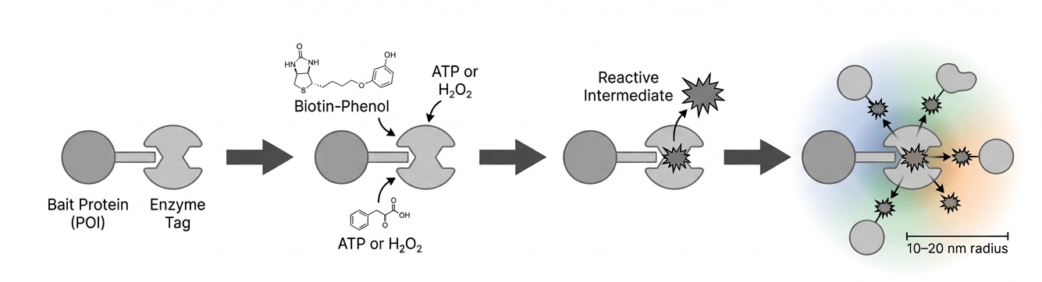
The Mechanism
Workflow of Proximity Labeling
An exogenous substrate added and initiated the reaction
The enzyme then generates a highly reactive, short-lived radical or adenylate intermediate.
The protein of interest (POI) fused to labeling enzyme.
Covalent labeling of nearby proteins
Generated by NotebookLM (Google)
Notes:
The mechanism follows a strict four-step process. First, the Protein of Interest (POI) is genetically fused to a promiscuous enzyme, remaining dormant until the researcher adds an exogenous substrate (like biotin) and a cofactor. The enzyme then generates a highly reactive, short-lived radical or adenylate that covalently marks proximal proteins within a 10–20 nm radius. This permanent tag survives the harsh conditions of denaturing lysis.
BirA is a 35-kD DNA-binding biotin protein ligase in Escherichia coli that regulates the biotinylation of a subunit of acetyl-CoA carboxylase and acts as a transcriptional repressor for the biotin biosynthetic operon (Chapman-Smith and Cronan, 1999). BirA has been harnessed for experimental applications, including use in eukaryotic cells. The BirA acceptor-peptide system takes advantage of the extreme specificity of BirA in biotinylating its substrate peptide (Beckett et al., 1999). With this system, a minimal recognition sequence, a biotin acceptor tag (BAT), is fused to a protein of interest and coexpressed with BirA. This leads to the biotinylation of the BAT sequence permitting one-step high affinity (Kd = 10−14 M; Green, 1963) avidin/streptavidin-mediated purification of the tagged protein. Because biotinylation is a rare modification, in mammalian cells it is restricted primarily to only a few carboxylases (Chapman-Smith and Cronan, 1999); BAT-independent binding is minimal. Biotinylation by BirA is a two-step process.
The first of these combines biotin and ATP to form biotinoyl-5′-AMP (bioAMP; Lane et al., 1964). This activated biotin is held within the BirA active site until it reacts with a specific lysine residue of the BAT sequence in the second step. For our purposes, the problem with BirA lies with its stringent selectivity for its endogenous substrate. What we desired was a far more promiscuous biotin ligase.
This requirement led us to certain BirA mutants that prematurely release the highly reactive yet labile bioAMP (Kwon and Beckett, 2000; Streaker and Beckett, 2006). One such BirA mutant (R118G, hereafter called BirA*), which is defective in both self-association and DNA binding (Kwon et al., 2000), displays an affinity for bioAMP two orders of magnitude less than that of the wild-type enzyme (BirA-WT; Kwon and Beckett, 2000). In E. coli, BirA* expression results in promiscuous protein biotinylation because free bioAMP will readily react with primary amines. More significantly however, it has been demonstrated in vitro that BirA* will promiscuously biotinylate proteins in a proximity-dependent fashion (Choi-Rhee et al., 2004; Cronan, 2005).

Slide 9
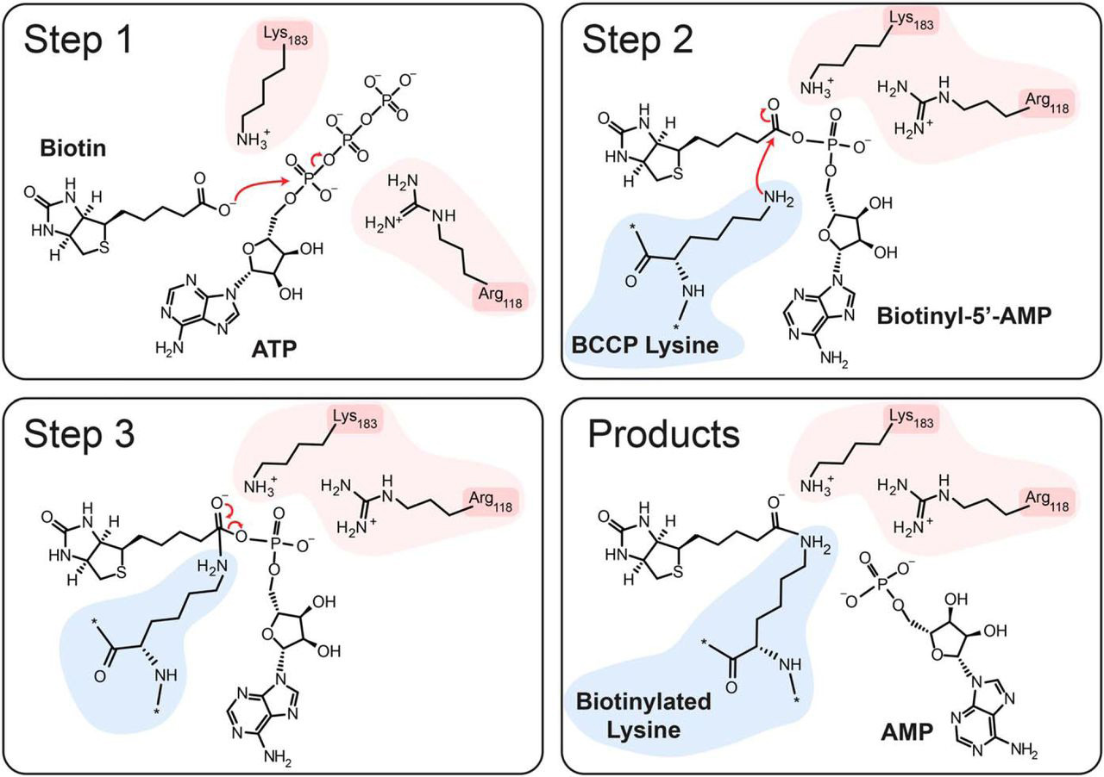
The Mechanism
Biochemical Basis: Biotinylation Mechanism
Biotin is first activated by ATP in the active site of biotin ligase (BirA), forming an intermediate, biotinyl-5′-AMP (bio-AMP).
The ε-amino group of Biotin carboxyl carrier protein (BCCP) lysine performs a nucleophilic attack on the carbonyl carbon of biotinyl-AMP.
This results in the formation of biotinylated lysine and the release of AMP.
Bagautdinov et al. Journal of Biological Chemistry 2008
Notes:
BirA 介导的生物素化是一个两步过程。 其中第一步反应是将生物素与 ATP 结合形成生物素酰-5′-AMP（bioAMP；Lane 等，1964）。这种活化生物素会保留在 BirA 活性位点，直到第二步与 BAT 序列中的特定赖氨酸残基发生反应。
What is the role of Arg118 and Lys183

Slide 10
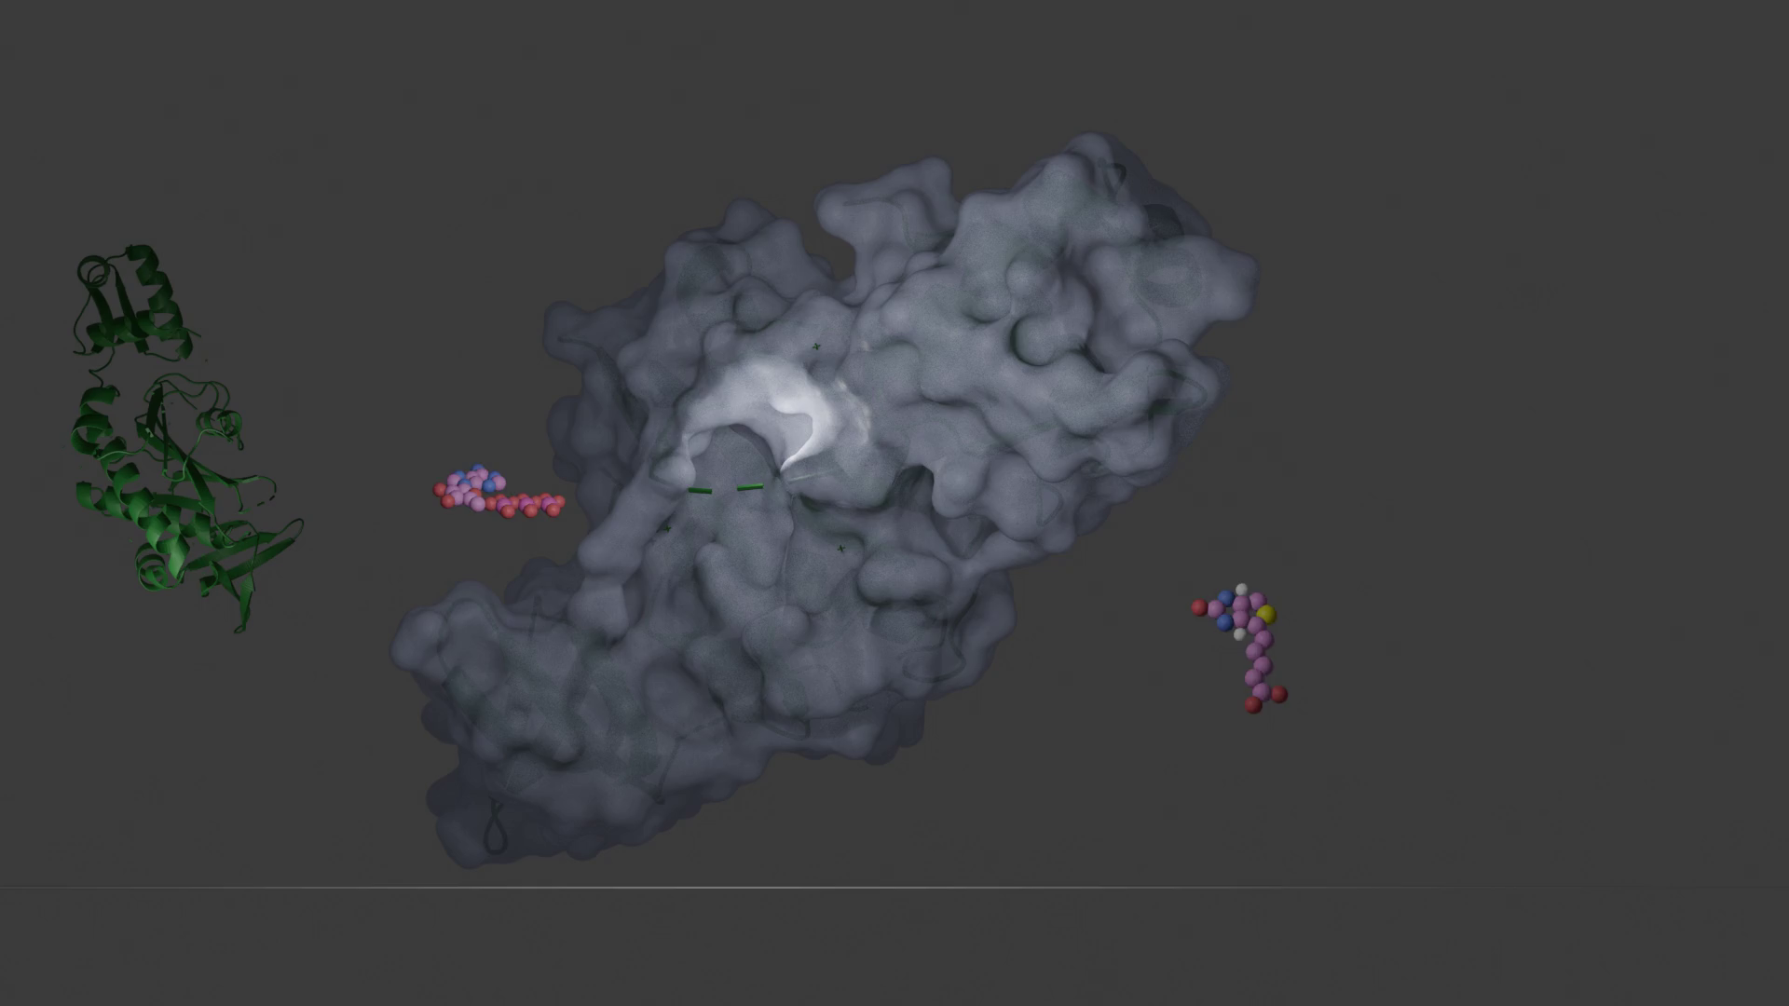

Slide 11
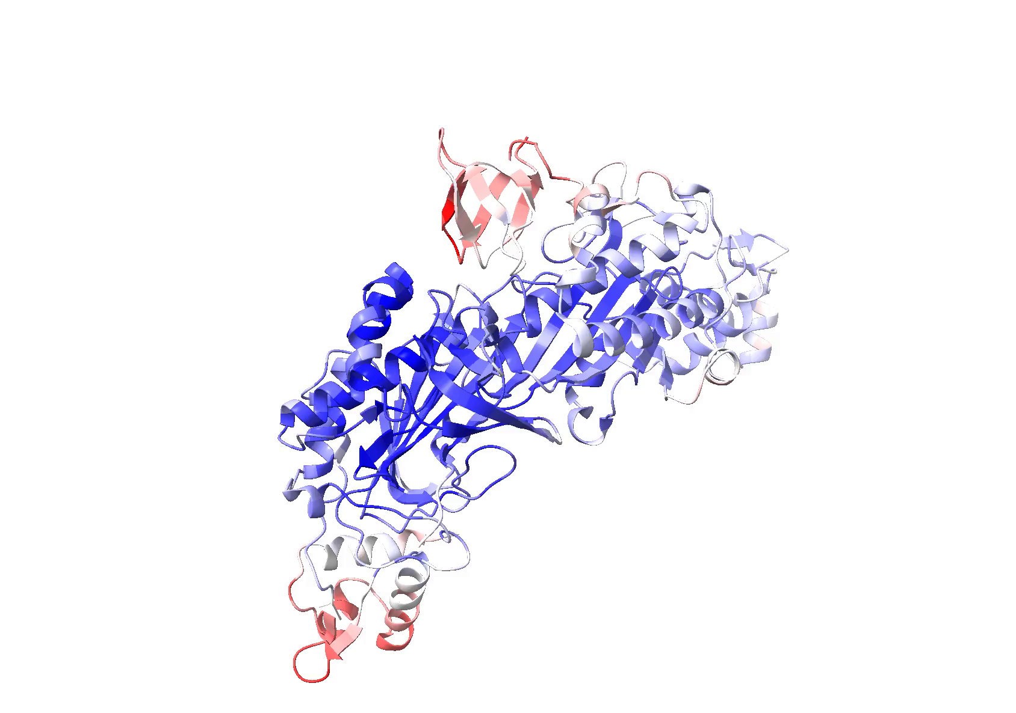
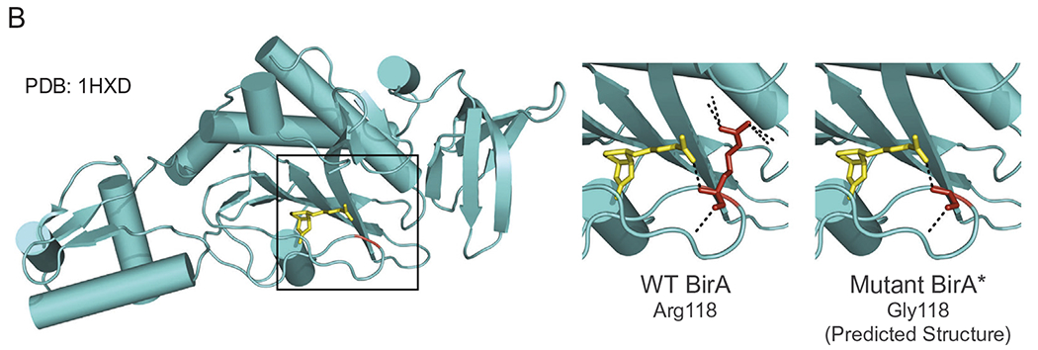
The Mechanism
Engineering BirA for Proximity Labeling
BirA
WT BirA: highly specific → limited labeling
Mutation enables release of reactive bioAMP
Basis of proximity labeling
Derived from E.coli biotin ligase
No-toxic and highly specific
compatible with in vivo animal models
Bifunctional role
Oostdyk et al. Methods 2019
Notes:
Here we see the specific transition from targeting to enrichment. The (BioID) enzyme* contains a critical R118G mutation
. This mutation decreases the ligase's affinity for biotinoyl-5'-AMP, causing it to "leak" this reactive intermediate, which then tags nearby lysines
. Once tagged, these proteins can be dissociated from the bait and still be recovered using affinity beads.

Slide 12
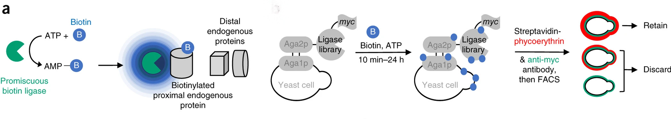
The Development
Efficient proximity labeling with TurboID
Branon et al. Nat Biotechnol 2018

Slide 13
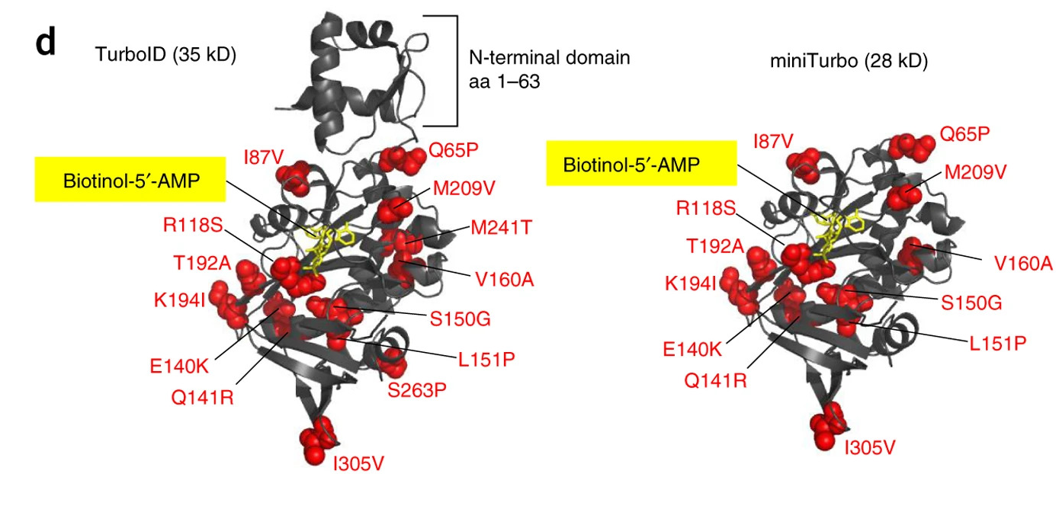
The Development
Efficient proximity labeling with TurboID
Directed Evolution of TurboID Enhances Proximity Labeling Efficiency and Kinetics
This engineering efforts yielded two promiscuous ligases: 35 kD TurboID, with 15 mutations relative to wild-type BirA; and 28 kD miniTurbo, with the N-terminal domain deleted and 13 mutations relative to wild-type BirA
Branon et al. Nat Biotechnol 2018
Notes:
Efficient proximity labeling in living cells and organisms with TurboID
Our engineering efforts yielded two promiscuous ligases: 35 kD TurboID, with 15 mutations relative to wild-type BirA; and 28 kD miniTurbo, with the N-terminal domain deleted and 13 mutations relative to wild-type BirA
E. coli biotin ligase structure (PDB: 2EWN) with sites mutated in TurboID (left) and miniTurbo (right) shown in red. The N-terminal domain (aa1–63) is also removed from miniTurbo. A non-hydrolyzable analog of biotin-5′-AMP, biotinol-5′-AMP, is highlighted in yellow.

Slide 14
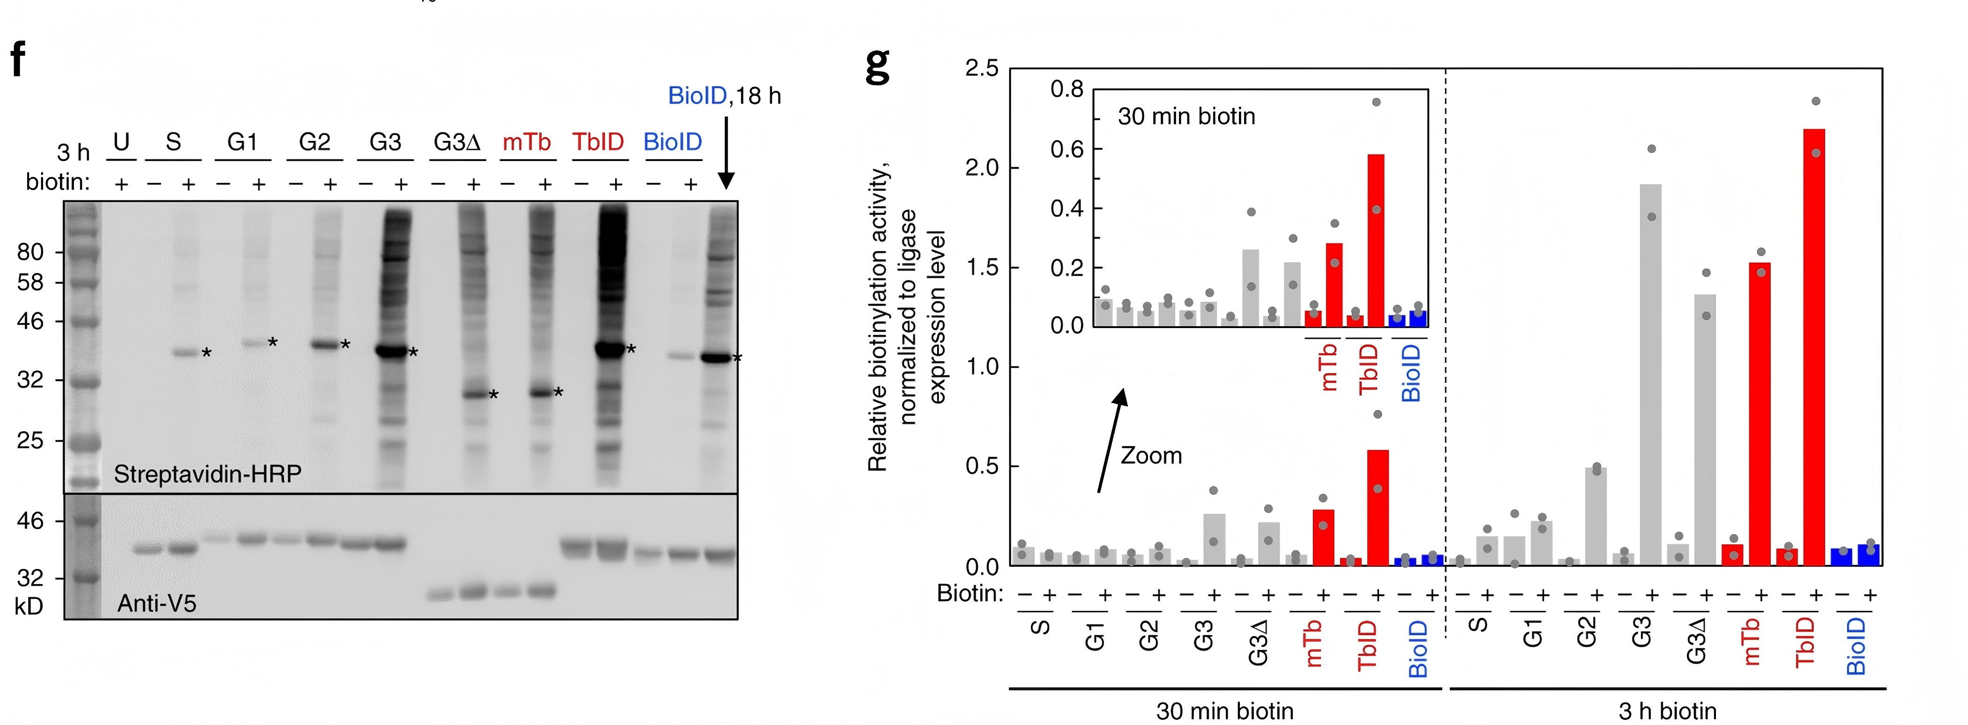
The Development
Directed Evolution of TurboID and miniTurbo
Through directed evolution, TurboID and miniTurbo dramatically compress this timescale, allowing labeling to be completed in as little as 30 minutes.
Branon et al. Nat Biotechnol 2018

Slide 15
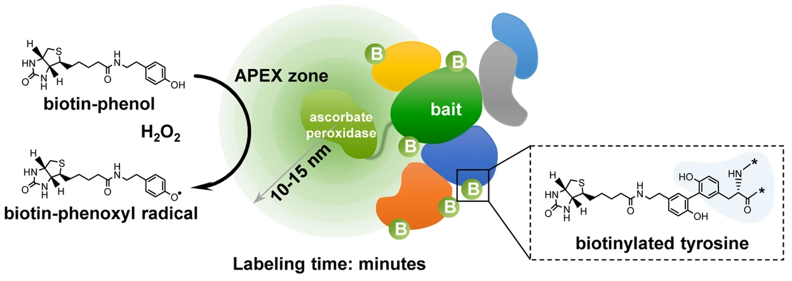
The Development
APEX/APEX2: Mechanism & Kinetics
Reaction Time: < 1 min (The "Flash" Labeling).
Radius: < 20 nm (High spatial resolution).
Output: Biotinylated proteins + EM contrast (DAB).
Qin et al. (2021) Annu Rev Anal Chem
Trinkle-Mulcahy (2019) Expert Rev Proteomics

Slide 16
The Proximity Labeling Trade-offs
The Development
Methods | Description | Advantages | Limitations
BioID | Biotin ligase converts biotin to biotinyl-5′-AMP to react with lysine residue of nearby proteins | High spatial resolution, Non-toxic to vivo application | Low temporal resolution Small labeling range (around 10 nm)
TurboID |  | High temporal resolution (compared with BioID)
APEX | Peroxidase generates highly reactive free radicals triggered by H2O2 to label proximal biomolecules in living cells | High spatial and temporal resolution, versatility for protein and RNA labeling | Limited in vivo application due to cytotoxicity of H₂O₂
Wang, Gang et al. (2026) Molecular & cellular proteomics: MCP
Roux, Kyle J et al. (2012) The Journal of cell biology
Hung, Victoria et al.(2014) Molecular cell

Slide 17
The Application

Slide 18
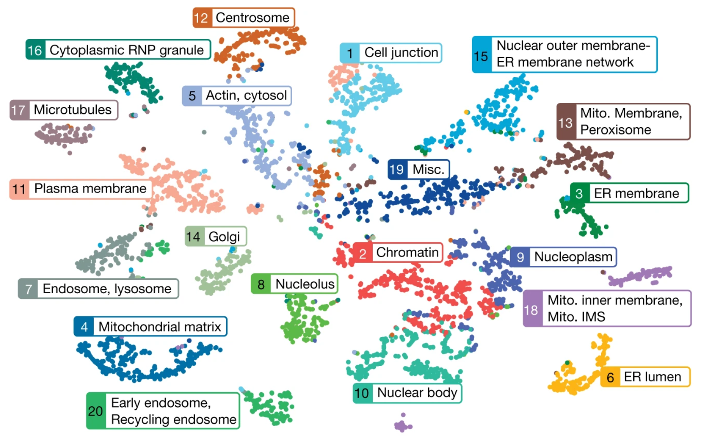
Case I: A Proximity Map of the Human Cell
The Application
Spatial Proteomics: The BioID Human Cell Map
192 baits profiled across 32 subcellular compartments in HEK293 cells, yielding 4,424 high-confidence proteins and 35,902 unique high-confidence proximity interactions.
Go, I. et al.(2021). Nature

Slide 19
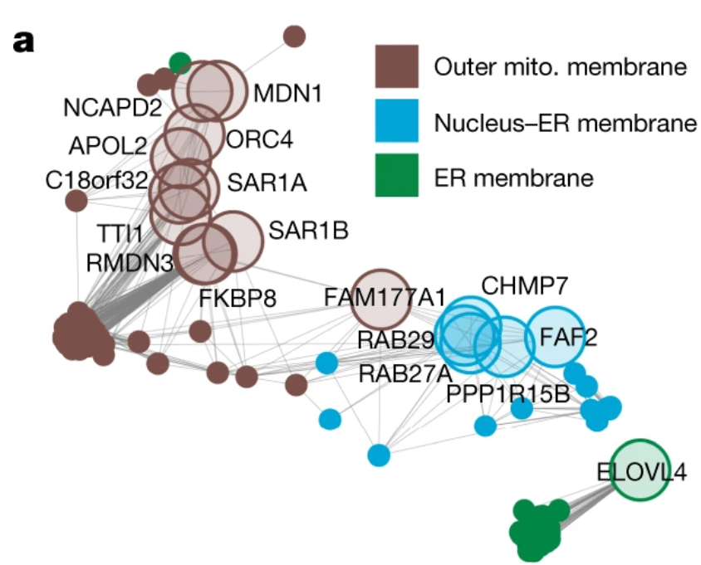
Case I: A Proximity Map of the Human Cell
The Application
Computational Synthesis: NMF (Non-negative Matrix Factorization) and SAFE Networks (Spatial Analysis of Functional Enrichment)
Translating 35,902 interactions into a spatial map requires advanced computational synthesis.
Go, I. et al.(2021). Nature

Slide 20
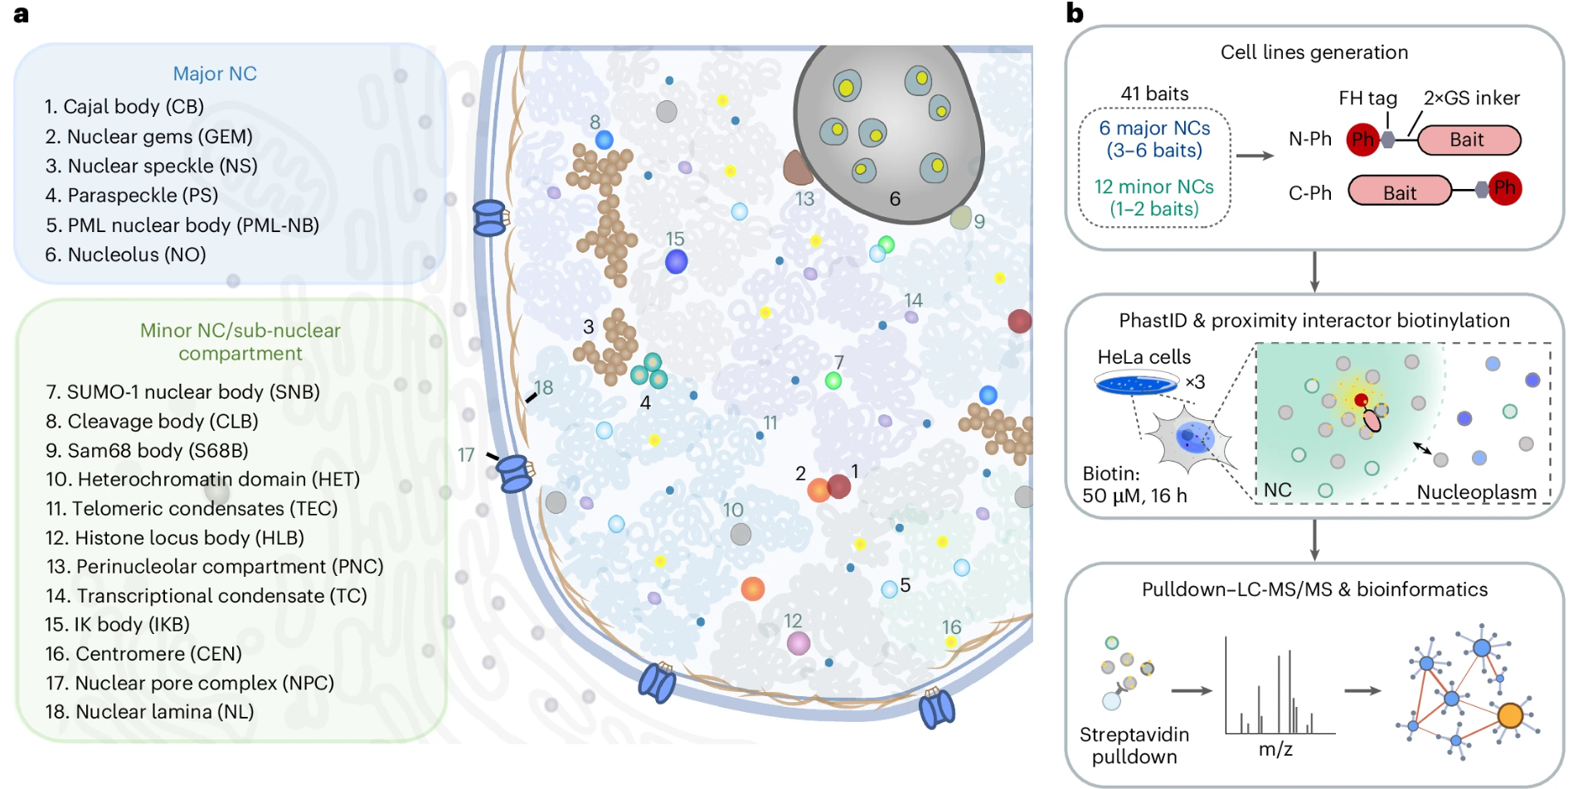
Case I: A Proximity Map of the Human Cell
The Application
Data Application
Li, Ruofei et al. (2025) Nature cell biology

Slide 21
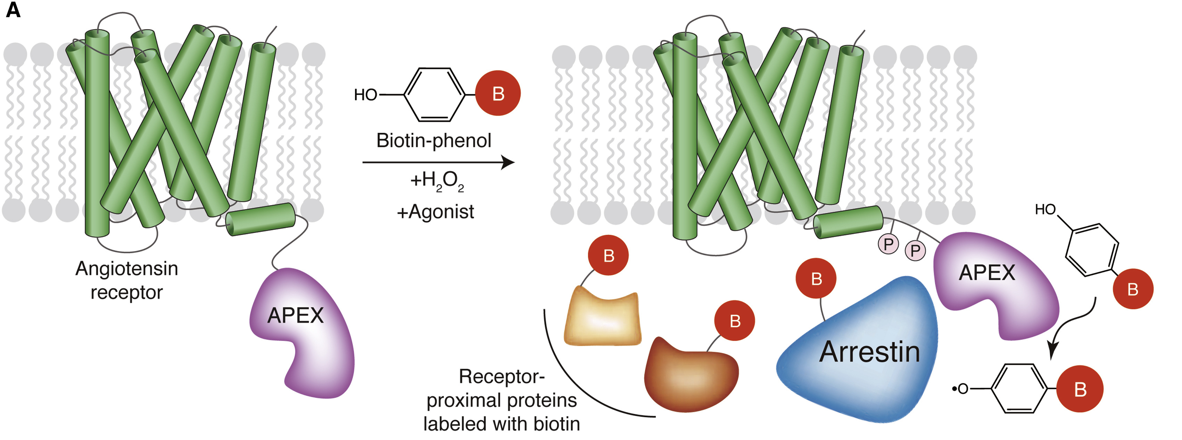
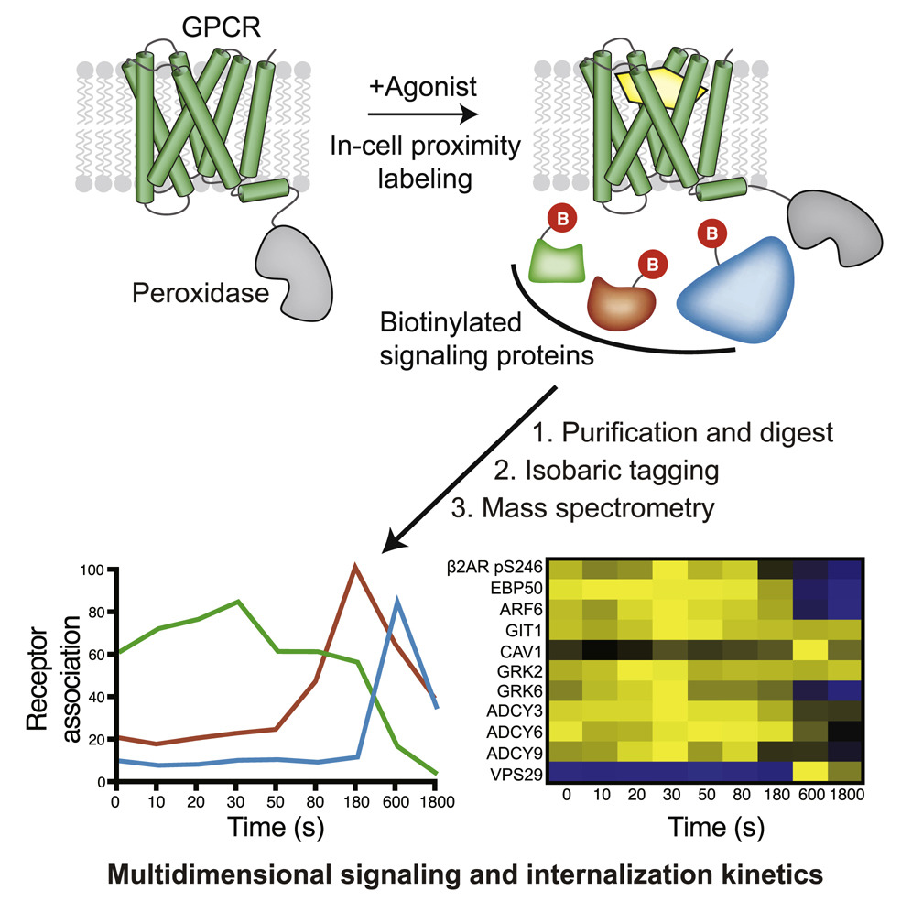
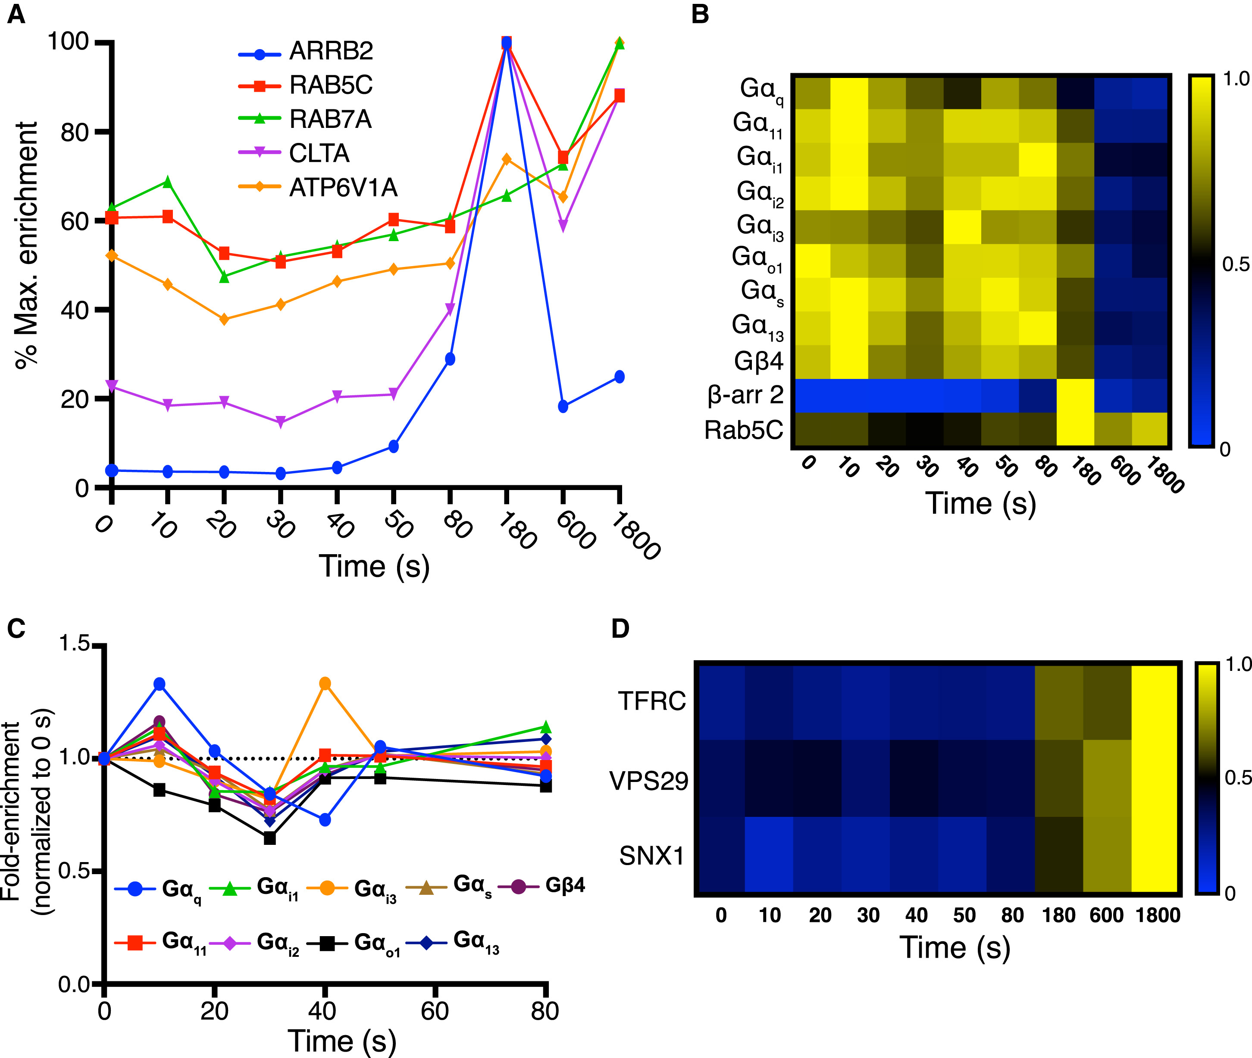
Case II: GPCR Dynamic Tracking
The Application
Linear plot
of protein
enrichment
Enrichment heatmap
Paek J et al. (2017) Cell

Slide 22
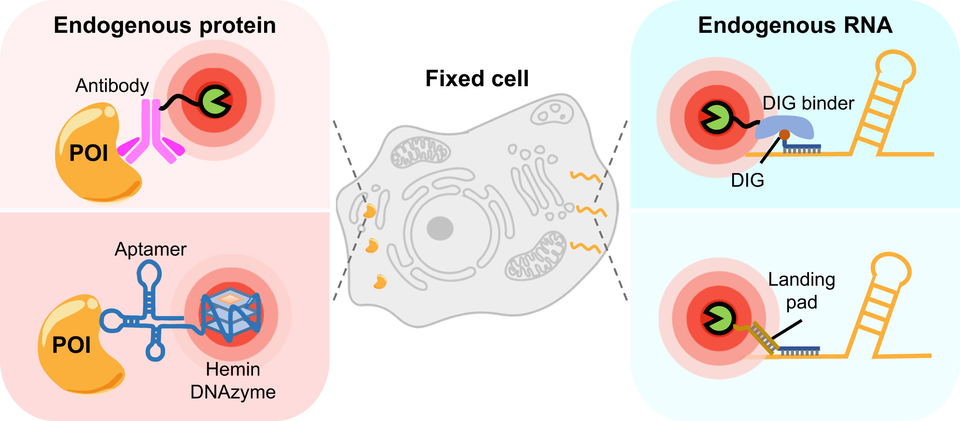
Beyond Canonical PL
The Application
Canonical PL methods (BioID,TurboID) require overexpression (potential artifacts)
Immuno-PL Uses Antibodies to guide the enzyme to the target.
Ideal for:Primary cells, tissue slices, and endogenous validation.
Li et al. (2021) Front Cell Dev Biol.
Wang, Gang et al. (2026) Molecular & cellular proteomics: MCP

Slide 23
Recent Advancement
The Application
Evolving advances of proximity labeling in capturing biomolecular interactions
Dang et al. Current Opinion in Chemical Biology 2025
An enzymatic cascade enables sensitive and specific proximity labeling proteomics in challenging biological systems
Sroka et al. Nat Commun 2025
Spatiotemporally resolved mapping of extracellular proteomes via in vivo-compatible TyroID
Zhang et al. Nat Commun 2025
Super-resolution proximity labeling with enhanced direct identification of biotinylation sites
Shin et al. Commun Biol 2024
Recent Advances in Proximity Labeling-Based Subcellular Proteomic Mapping.
Wang, Gang et al. Molecular & cellular proteomics 2026

Slide 24
THANKS

